Slide 1
Setting a Table for Lunch and Dinner
Setting up a table for lunch or dinner depends on the type of menu being served. The basic two type of menu served are a la carte and table d’ hote.

Slide 2
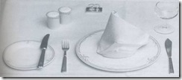
For A la Carte Menu:
This a table setting normally laid in a good class restaurant, dining room or hotel in readiness for serving of either lunch or dinner. It would usually consist of the following:
Main Plate
Napkin
Main knife
Main fork
Side plate
Side knife
Water or wine glass.

Slide 3
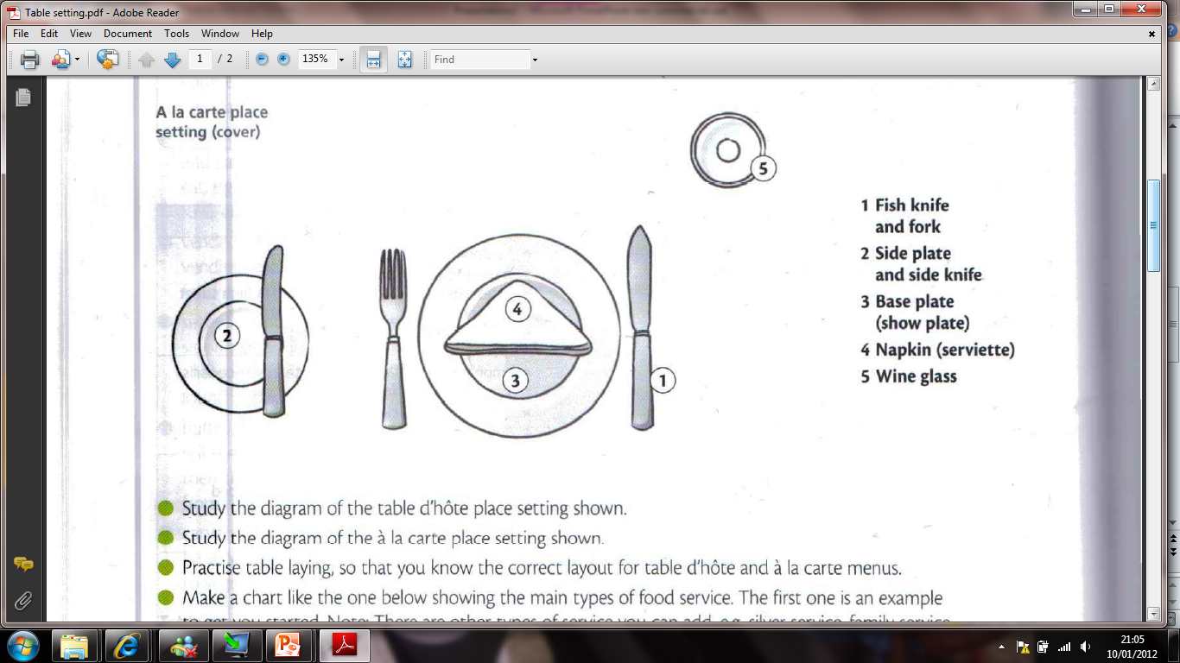
For A la Carte Menu:

Slide 4
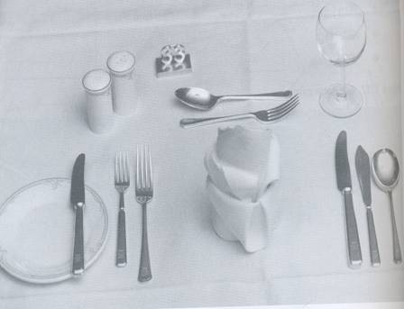
Table d’ hote Menu:
It would usually consist of the following:
Napkin
Soup spoon
Fish knife
Fish fork
Main knife
Main fork
Sweet spoon
Sweet fork
Side plate
Side knife
Water or wine glass

Slide 5
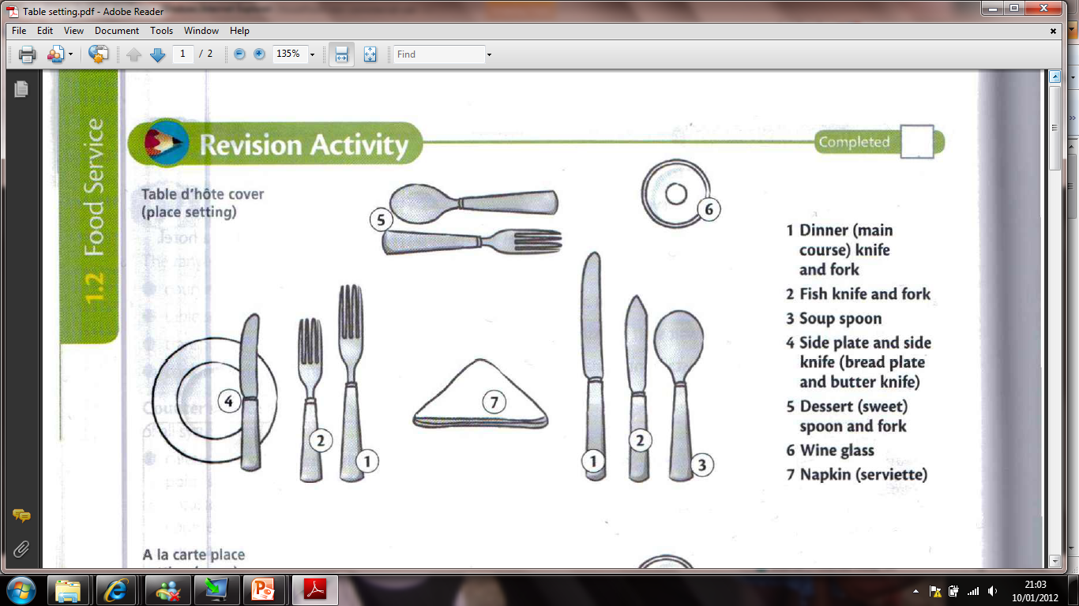
Table d’ hote Menu:

